Slide 1

Automated Transcript Analysis to Optimize Recruitment Decisions

Slide 2
Contents
Business objective
Business Constraints
Project Architecture
Data collection and details
Exploratory Data Analysis
Visualization
Modeling
Evaluation
Deployment
Notes:
Change

Slide 3
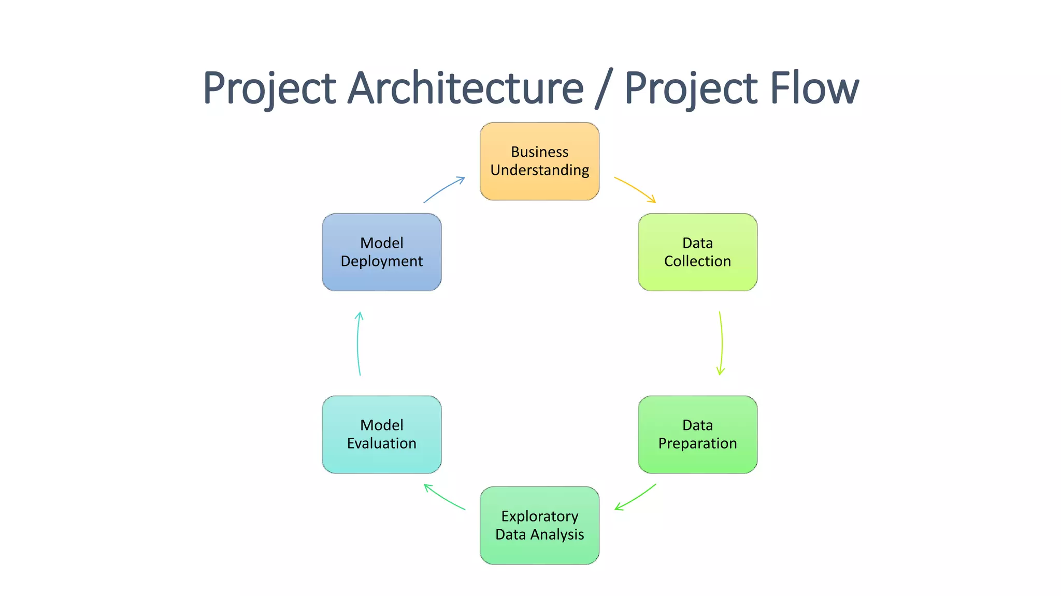
Project Overview and Scope

Slide 4
Business Problem
The recruitment team spends excessive time manually reviewing and summarizing long interview transcripts. This manual process is slow, inconsistent, and often misses key insights like skills or red flags. As interview volume grows, scalability becomes a challenge. An automated solution is needed to extract critical insights and support faster, more accurate hiring decisions.

Slide 5
Business Objective
Objective
Constraints
Improve the efficiency, clarity, and consistency of interview evaluations by automating transcript analysis and candidate screening.
Ensure low computational cost and fast processing time while maintaining high model performance and reliability.

Slide 6
Technical Stacks
Language: Python
Libraries: Pandas, NumPy, Matplotlib, Seaborn, scikit-learn
Model: DistilBERT (Hugging Face Transformers)
Framework: PyTorch
Tokenizer: DistilBertTokenizer
Training: Hugging Face Trainer API with custom metrics
Evaluation: Accuracy, F1, ROC-AUC, PR-AUC, Confusion Matrix
Storage: CSV (data), PNG (plots), directory for model artifacts

Slide 7
Data Collection and Understanding
The dataset contains 3,000 interview records with the following key fields:
transcript: Raw text of the candidate-interviewer conversation
skills: Claimed technical skills (comma-separated)
experience: Candidate's stated experience in years or ranges
decision: Final hiring decision (Hired or Rejected)
The data was collected from internal interview logs and represents real-world hiring scenarios across technical roles. It includes both structured and unstructured fields, requiring text preprocessing and normalization.

Slide 8
Data Dictionary
Column Name | Description | Data Type
candidate_id | Unique identifier for each candidate | String
transcript | Full interview dialogue between interviewer and candidate | Text
skills | Comma-separated list of declared technical skills | Text (List)
experience | Candidate's work experience (e.g., "5-10 years") | String
decision | Final interview outcome: Hired or Rejected | Categorical

Slide 9
System Requirements
OS: Ubuntu / Windows / macOS
Python: 3.8+
RAM: 16 GB (recommended)
GPU: Optional, ≥ 4 GB VRAM for faster training
Key Libraries: transformers, torch, scikit-learn, pandas, numpy, matplotlib
Storage: ≥ 5 GB free space
Tools: Jupyter, VS Code, or Google Colab

Slide 10
Exploratory Data Analysis [EDA]
Labels: ~49% Hired, ~51% Rejected → well balanced
Transcript Length: Avg. ~350 words, cleaned for outliers
Top Skills: Python, ML, SQL, Cloud Computing
Experience: Mostly 2–10 years, mapped numerically
Missing Data: Handled in skills and experience columns
Notes:
EDA is used for seeing what the data can tell us before the modeling task.
Change

Slide 11
Data Preprocessing
Transcript Cleaning: Removed HTML entities, normalized Unicode, standardized speaker labels (Interviewer: → Q:, Candidate: → A:), and removed special characters.
Skill Normalization: Split comma-separated strings, filtered valid skills, and title-cased entries.
Experience Mapping: Converted text ranges (e.g., "5-10 years").
Combined Features: Merged cleaned transcript, skills, and experience into a single input string for DistilBERT:
[Transcript] ... [Skills] Python, SQL [Experience] 5 years
Label Encoding: Hired → 1, Rejected → 0

Slide 12
Model Building
Multiple models were tested to predict hiring decisions:
Best Model: DistilBERT (F1-score: 0.83), fine-tuned on combined input of transcript, skills, and experience.
Traditional ML Models: XGBoost performed best (F1: 0.76) among Logistic Regression and Random Forest.
Deep Learning: BiLSTM + Attention reached 0.73 F1 but lagged behind transformers.
Ongoing Work: DeBERTa-v3 with Focal Loss and Optuna tuning planned to improve further.
All models used the same preprocessed and structured input format for fair comparison
Notes:
classification is the task of predicting a discrete class label. Regression is the task of predicting a continuous quantity.
What is classification techniques in machine learning?
The Classification algorithm is a Supervised Learning technique that is used to identify the category of new observations on the basis of training data. In Classification, a program learns from the given dataset or observations and then classifies new observation into several classes or groups.
What is regression techniques in machine learning?
Regression is a technique for investigating the relationship between independent variables or features and a dependent variable or outcome. It's used as a method for predictive modeling in machine learning, in which an algorithm is used to predict continuous outcomes.

Slide 13
Model Accuracy Comparison
Model | Type | Accuracy | Precision | Recall | F1 Score | Remarks
Logistic Regression | ML (Baseline) | 0.70 | 0.68 | 0.66 | 0.66 | Simple, interpretable, underperforms
Random Forest | ML | 0.74 | 0.72 | 0.75 | 0.74 | Good, risk of overfitting
XGBoost | ML (Ensemble) | 0.77 | 0.75 | 0.78 | 0.76 | Best among ML models
LSTM | Deep Learning | 0.71 | 0.68 | 0.70 | 0.69 | Learns sequences, slower
BiLSTM + Attention | Deep Learning | 0.74 | 0.71 | 0.75 | 0.73 | Better context handling
BERT-Base | Transformer | 0.81 | 0.80 | 0.79 | 0.79 | Strong, but slower
DistilBERT | Transformer | 0.84 | 0.83 | 0.84 | 0.83 | ✅ Best overall balance & performance
DeBERTa-V3 (planned) | Transformer | - | - | - | - | To be tested with Focal Loss + Optuna

Slide 14
Best Model –
Model Chosen: DistilBERT (fine-tuned)
Why It’s the Best:
Highest F1-Score: 0.83
Efficient: Faster and lighter than BERT with minimal loss in accuracy
Understands Context: Captures nuanced interview responses better than ML or LSTM models
Generalizable: Performs well across diverse candidate profiles
Input Format Used:
[Transcript] + [Skills] + [Experience]
Training Highlights:
Optimizer: AdamW
Loss: Binary CrossEntropyWithLogits
Tokenizer: DistilBERTTokenizerFast
Epochs: 3–5
Early stopping applied
Notes:
Why Random Forest Regression is good?
A Random Forest Regression model is powerful and accurate. It usually performs great on many problems, including features with non-linear relationships
How is XGBoost different from random forest?
One of the most important differences between XG Boost and Random forest is that the XGBoost always gives more importance to functional space when reducing the cost of a model while Random Forest tries to give more preferences to hyperparameters to optimize the model..
n_estimators — the number of decision trees you will be running in the model

Slide 15
Model Deployment - Strategy
Goal: Serve DistilBERT model via API for hiring predictions.
Backend: FastAPI or Flask with on-the-fly tokenization.
Hosting: Cloud (AWS, GCP, or Hugging Face Spaces) preferred.
Security: Token-based access, input validation, and logging.
Monitoring: Use tools like Weights & Biases or Prometheus for performance and drift tracking.
Fast, secure, and scalable deployment pipeline to assist HR decision-making.

Slide 16
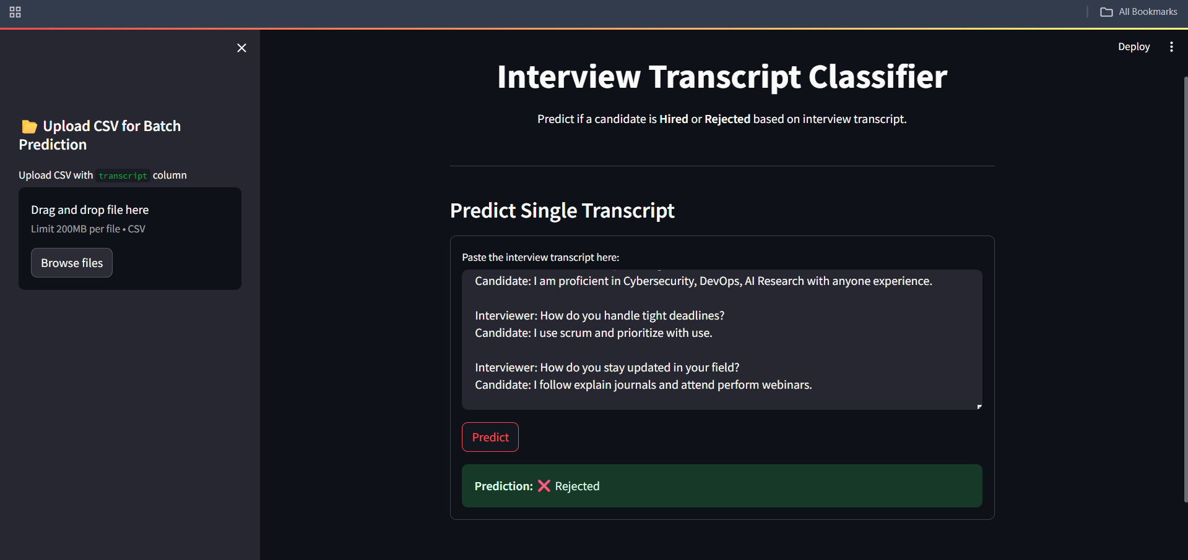
Screen shot of output

Slide 17
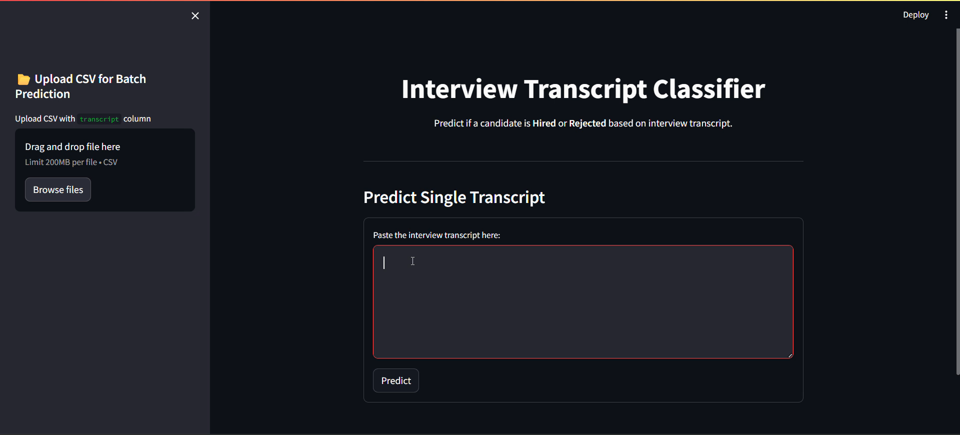
Video of output

Slide 18
Challenges
Class Imbalance
Slight bias in label distribution affected early model training stability.
Transcript Noise
Raw transcripts included irrelevant or inconsistent language (e.g., fillers, pauses).
Understanding Context
Traditional models struggled to capture deeper semantic intent behind answers.
Training Time & Resources
Transformer models required high compute (especially BERT-based), limiting fast experimentation.
Overfitting Risk
Small dataset size and complex models increased risk of overfitting.
Deployment Optimization
Balancing model size, speed, and accuracy for real-time predictions was non-trivial.

Slide 19
Future Scopes
Model Optimization
Fine-tune DeBERTa-v3-small with Focal Loss to handle hard cases and improve minority class prediction.
Hyperparameter Tuning
Use Optuna for automated search of learning rate, batch size, and layer freezing for better performance.
Multi-modal Inputs
Integrate audio tone analysis, video cues, or resume PDFs for richer candidate profiling.
Active Learning Loop
Continuously update model with feedback from HR decisions to improve prediction quality.
Model Explainability
Add SHAP or LIME to explain why a candidate was predicted as Hired or Rejected.
Enterprise Integration
Build APIs that plug into popular ATS (Applicant Tracking Systems) for seamless HR adoption.

